Slide 1

Software Verification and Validation Presentation
AI-Powered Document
Retrieval System
Enterprise RAG system verification and validation
Hof University of Applied Sciences
Software Engineering for Industrial Applications
Prepared By
Md Fahim Hossain
Email: md.hossain.4@hof-university.de
AI-powered enterprise document retrieval system | Md Fahim Hossain | July 2026
01 / 11
Notes:
Good morning, everyone.
My name is Md Fahim Hossain, and today I will present the verification and validation activities carried out for the AI-powered enterprise document retrieval system developed during my internship at Siemens Energy.
While the first presentation focused on specification and design, this presentation focuses on how the implemented system was checked against its requirements and validated through realistic user workflows.

Slide 2

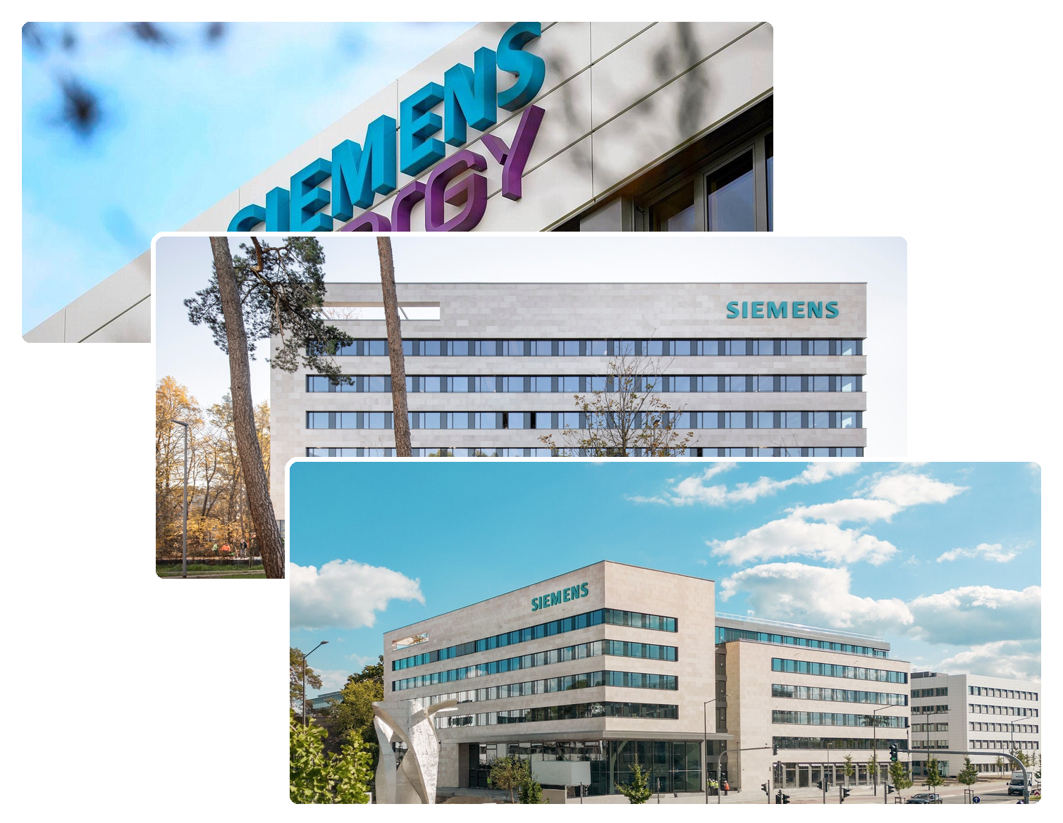
PRESENTATION OVERVIEW
Agenda
1. Company and Internship
2. Project Epic
3. Requirements
4. Test Cases
5. Validation
6. Results
7. Conclusion
AI-powered enterprise document retrieval system | Md Fahim Hossain | July 2026
02 / 11
Notes:
I will begin with the company and internship context, followed by the project epic.
Then I will present the functional and non-functional requirements that formed the basis for testing.
After that, I will show how the test cases were linked to those requirements.
The validation section covers the complete user journey and the conditions used to decide when a feature was considered complete.
Finally, I will present the measured results, explain the role of manual testing, and summarize the overall outcome.

Slide 3
INTRODUCTION
Company and Internship
Siemens Energy
Industrial digitalization environment
Project Scope
Enterprise documents
SE GT DG OE
Knowledge retrieval
Department supporting digital solutions
Secure access
Academic reporting
Internship Role
Software engineering and digitalization
AI-powered enterprise document retrieval system | Md Fahim Hossain | July 2026
03 / 11
Notes:
The project was completed at Siemens Energy within the SE GT DG OE department.
The department supports digitalization initiatives and develops solutions that improve information access, process efficiency, and internal software workflows.
During my internship, I worked in a software engineering and digitalization role.
My responsibilities included requirement analysis, backend and interface development, document-processing workflows, testing, code review, and technical documentation.
The project itself focused on enterprise documents, secure knowledge access, and conversational retrieval.
Because the system handles user-owned documents and generated conversations, verification had to cover not only functionality, but also security, reliability, performance, and correct behaviour under realistic conditions.

Slide 4
INTRODUCTION
Project Epic
1
2
3
4
Documents grew
Users asked
System retrieved
Responses grounded
Knowledge became hard to locate
Natural questions needed answers
Relevant chunks provided context
Answers referenced document sources
From document overload to guided retrieval
The system turns enterprise documents into searchable knowledge.
AI-powered enterprise document retrieval system | Md Fahim Hossain | July 2026
04 / 11
Notes:
The project epic describes the main problem the system was designed to solve.
Enterprise knowledge was distributed across a growing number of reports, manuals, and technical documents.
As the document collection increased, locating specific information became more difficult and time-consuming.
The system addressed this by allowing users to ask questions in natural language.
Relevant document sections were retrieved and used to generate grounded responses.
The responses also included source references so that users could check the origin of the information.
From a verification and validation perspective, the important question was not only whether the system could generate an answer.
It also had to be verified that the correct documents were used, that unavailable documents were excluded, that references were shown, and that the workflow remained reliable from upload to conversation history.

Slide 5
Verification
Requirements
Functional
Non-functional
FR-1: Upload and manage documents
NFR-1: Upload acknowledgement <= 3 seconds
FR-2: Process content; track readiness
NFR-2: >=90% queries within <=20 seconds
FR-3: Answer from selected documents
NFR-3: Support ≥ 10 concurrent users
FR-4: Show source references
NFR-4: Isolate user data; enforce RBAC
FR-5: Preserve conversation history
AI-powered enterprise document retrieval system | Md Fahim Hossain | July 2026
05 / 11
Notes:
The verification process was based on a defined set of functional and non-functional requirements.
The functional requirements covered five main areas.
First, users should be able to upload, view, and delete their documents.
Second, the uploaded content should be processed automatically, and the user should be able to monitor when a document becomes ready.
Third, the system should answer questions using only the selected documents.
Fourth, generated responses should include source references.
Finally, conversation history should be preserved and available for later continuation.
The non-functional requirements introduced measurable quality targets.
A successful upload should be acknowledged within three seconds.
At least ninety percent of questions should receive a response within twenty seconds under normal conditions.
The application should support at least ten concurrent authenticated users without failure or inconsistent data.
The security requirement also stated that user data must remain isolated and administrative functions must be protected through role-based access control.
These requirements provided the basis for the verification evidence shown on the next slide.

Slide 6
VERIFICATION
Test Cases and Traceability
Functional traceability
Req. | Linked tests | Verification level
FR1 | TC-1: Upload TC-6: Deletion | Functional
FR2 | TC-2: Processing | Unit + Integration + Functional
FR3 | TC-3: Q&A TC-4: Multi-document | Unit + Integration + Functional
FR4 | TC-3: Q&A TC-4: Multi-document | Unit + Functional
FR5 | TC-5: History | Functional
Non-functional traceability
Req. | Verification evidence | Level
NFR1 | 10-upload timing test | Load
NFR2 | 20-query timing test | Load
NFR3 | 10-user stability test | Load
NFR4 | Access-control checks | Functional + Acceptance
Unit
Integration
Load
Functional
Acceptance
AI-powered enterprise document retrieval system | Md Fahim Hossain | July 2026
06 / 11
Notes:
This slide shows the connection between the requirements and the verification activities.
On the left, the functional requirements are linked to specific test cases.
FR1, which covers document management, was verified through the upload and deletion test cases.
FR2, which covers document processing and readiness, was checked at several levels. Unit tests verified individual processing services, integration tests checked communication between components, and functional testing verified the complete processing workflow.
FR3 and FR4 were tested through question answering and multi-document retrieval. These tests checked whether the correct document content was retrieved and whether references were displayed with the response.
FR5 was verified by reopening previous conversations and confirming that the message history remained available.
On the right, the non-functional requirements are linked to measurable evidence.
Upload performance was tested using ten uploads.
Question performance was evaluated using twenty requests.
Concurrent stability was checked with ten users.
Access control was verified through functional and acceptance testing.
The main purpose of this traceability was to ensure that no requirement remained without corresponding verification evidence.

Slide 7
VALIDATION
End-to-End Tests
Upload document
Processing reaches Ready
Select Ready documents
Ask a natural-language question
1
2
Upload accepted & status tracked
Failed docs excluded from retrieval
Only user's own docs selectable
Natural-language query accepted
Reopen conversation
Continue with preserved history
Retrieve grounded answer
Display source references
4
3
Follow-up questions keep context
Past conversations remain accessible
Relevant chunks retrieved via RAG
Response includes source citations
AI-powered enterprise document retrieval system | Md Fahim Hossain | July 2026
07 / 11
Notes:
The end-to-end tests validated the complete workflow from the user’s perspective.
The first step was document upload.
The system had to accept a supported file, confirm the upload, start background processing, and display the current status.
The document then had to reach the Ready state before becoming available for retrieval.
Failed or incomplete documents were expected to remain excluded.
The second step was document selection and question submission.
Only processed documents belonging to the authenticated user should be selectable.
The user then submitted a natural-language question through the conversation interface.
In the third step, the system retrieved relevant chunks, generated a grounded answer, and displayed the related source references.
The final step was conversation continuity.
The user reopened an earlier conversation, reviewed the previous messages, and submitted a follow-up question while preserving the existing context.
This end-to-end path validated the system as one connected workflow rather than as a collection of isolated functions.

Slide 8
VALIDATION
Definition of Done
Engineering gate
Acceptance gate
Internal quality checks
User-facing completion checks
✓
Feature implemented
◉
UI feedback verified
↻
Code reviewed
✓
Acceptance criteria met
T
Tests passed
!
No critical issues open
A feature was complete only after all gates passed.
AI-powered enterprise document retrieval system | Md Fahim Hossain | July 2026
08 / 11
Notes:
The Definition of Done was used to decide when a feature could be considered complete.
It was divided into an engineering gate and an acceptance gate.
The engineering gate focused on internal software quality.
A feature first had to be implemented according to the defined requirement.
The code then had to be reviewed for correctness, readability, separation of responsibilities, error handling, and compatibility with the existing application.
Relevant automated and functional tests also had to pass.
The acceptance gate focused on user-facing completion.
The interface behaviour and feedback messages had to be checked.
The acceptance criteria defined in the corresponding user story had to be satisfied.
Finally, no critical issue could remain open.
A feature was therefore not considered complete simply because the code had been written.
It had to pass both the engineering and acceptance gates.

Slide 9
EVIDENCE
Results and Manual Testing
1
2
3
0.18 s
4
10 users
0.8–2.4 s
95%
Upload acknowledgement
Queries within 20 seconds
Average retrieval time
Concurrent stability
Target ≤ 3 s
Target ≥ 90%
Vector search
Passed
Manual validation focus
✓
Response references verified
✓
User interface behaviour checked
✓
End-to-end workflows validated
✓
All defined performance targets passed; no critical issues found
AI-powered enterprise document retrieval system | Md Fahim Hossain | July 2026
09 / 11
Notes:
This slide summarizes the main measured results.
For upload acknowledgement, ten uploads were tested while background processing was active.
The acknowledgement times ranged from 0.8 to 2.4 seconds, which remained below the target of three seconds.
For question answering, twenty queries were measured.
Ninety-five percent returned within twenty seconds, exceeding the required target of ninety percent.
The vector-search stage had an average retrieval time of 0.18 seconds.
Although no separate numerical target was defined for this stage, the result showed that semantic retrieval remained responsive.
The concurrent-user test was performed with ten authenticated users.
The system remained stable, and no inconsistent document or conversation states were observed.
Manual validation was also necessary because some aspects could not be assessed meaningfully through automated checks alone.
The references were reviewed to confirm that they matched the generated answers.
The interface behaviour, confirmation messages, error feedback, and status updates were checked manually.
The complete end-to-end workflows were also validated under realistic usage conditions.
Overall, all defined performance targets passed, and no critical issue remained open.

Slide 10
CLOSING
Conclusion
Verified requirements and workflows
Validated realistic user journeys
Measured performance targets passed
References supported answer checking
System remained stable concurrently
Verification and validation increased confidence
in the Enterprise RAG system.
AI-powered enterprise document retrieval system | Md Fahim Hossain | July 2026
10 / 11
Notes:
To conclude, the verification and validation activities provided evidence that the system met its main requirements.
The functional workflows were verified through unit, integration, load, functional, and acceptance testing.
The complete user journey was validated from document upload to grounded question answering and conversation continuation.
The measurable targets for upload acknowledgement, question response time, and concurrent-user stability were achieved.
Source references supported the manual checking of generated responses, while access-control testing confirmed that user data remained isolated.
The combination of automated tests, measured performance results, and manual validation increased confidence that the system behaves correctly under the intended operating conditions.

Slide 11
Thank you for your attention
Questions?
Enterprise RAG system | Internship presentation
AI-powered enterprise document retrieval system | Md Fahim Hossain | July 2026
11 / 11
Notes:
That concludes my presentation on the software verification and validation of the AI-powered enterprise document retrieval system.
Thank you very much for your attention.
I am happy to answer any questions regarding requirement traceability, the test design, the measured results, the end-to-end workflows, or the Definition of Done.

